Slide 1
Dynamic Programming
Module 2
Sem IV
AoA Even 2022-23

Slide 2
Introduction
Richard Bellman invented dynamic programming technique in 1950s
It is an algorithm design technique used for solving optimization problems.
Similar to Divide and Conquer technique as it divides original problem into several subproblems.
This technique starts with finding optimal solution for a smallest problem and then gradually enlarges the problem.
In dynamic programming, same subproblems are not solved once and results are stored in a table for later use.

Slide 3
Example
Fibonacci Series:
Recursive formula for calculating nth element of the Fibonacci series:
fib(n) = fib(n-1) + fib(n-2)
When solving using D&C same functions are called again and again.
Problem can be solved using Dynamic programming by storing the result of intermediate problems in table.
Here many sub problems such as fib(2), fib(1) and fib(0), which are overlapping.
Here, dynamic programming technique follows bottom-up approach.

Slide 4
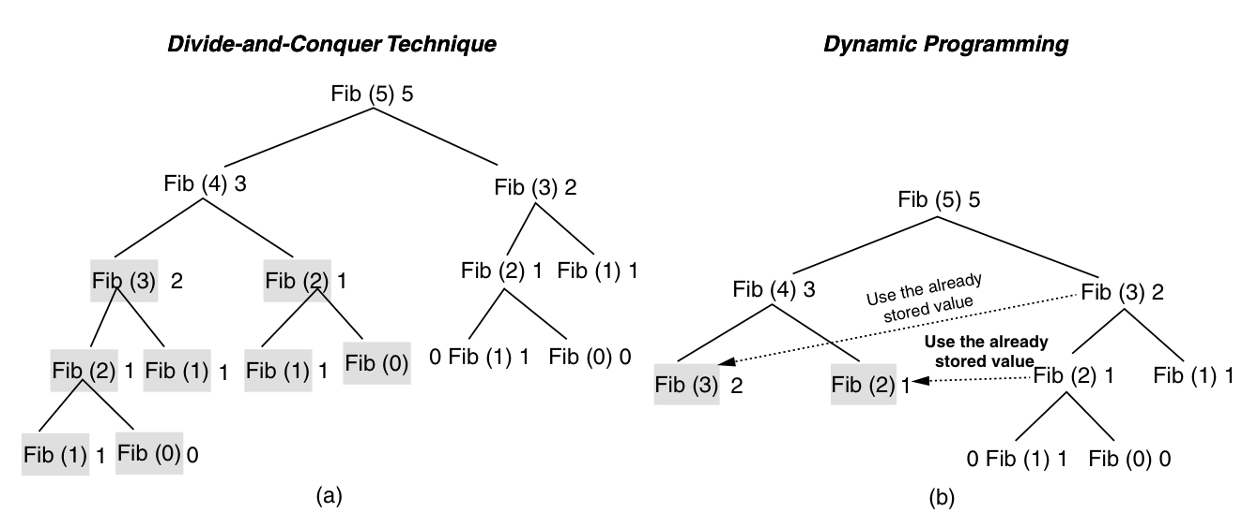
Example

Slide 5
Example
Fibonacci Series: Recursive Algorithm
fib(int n)
{
if ((n==0) || (n==1))
return n;
else
return fib(n-1) + fib(n-2);
}

Slide 6
Example
Fibonacci Series:
Dynamic Programming improves time complexity
In dynamic programming, values are stored in a table for later use.
Fibonacci Series: Iterative Algorithm
fib(int a[],int n)
{
int n;
if ((n==0) || (n==1))
return n;
a[0]=0; a[1]=1;
for(i=2; i<=n; i++)
a[i] = a[i-1] + a[i-2];
return a[n];
}
The time complexity of Iterative algorithm is O(n), since loop runs n-1 times.

Slide 7
Characteristics of Dynamic Programming
1. Optimal Substructure:
Problems can be decomposed into several subproblems.
Optimal solutions to subproblems are found and solution of original problem is expressed in terms of solutions for smaller problems.
Optimal solution contains optimal subsolution, then problem exhibits optimal substructure.
2. Overlapping Subproblems:
When recursive algorithm revisits same subproblem over and over, the problem is said to have overlapping subproblem

Slide 8
Characteristics of Dynamic Programming
Principle of Optimality:
Dynamic Programming works on a principle of optimality.
Sequence of decision to be made at every stage in dynamic programming starting from smallest subproblem.
The principle of optimality states that
"the optimal solution of a problem is a combination of optimal solutions to some of its subproblems".

Slide 9
Applications of Dynamic Programming
Longest Common Subsequence(LCS)
0/1 Knapsack Problem
Travelling Salesman Problem
Single Source shortest path (Bellman Ford Algorithm)
All pair shortest path (Floyd Warshall Algorithm)
Matrix chain Multiplication
Multistage graphs

Slide 10

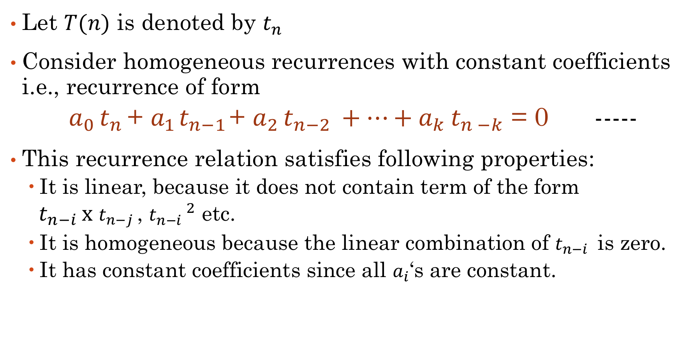
Homogeneous Recurrences
Let $T(n)$ is denoted by $t_{n^{ }}$
Consider homogeneous recurrences with constant coefficients i.e., recurrence of form
$a_{0^{ }}t_{n^{ }}$+ $a_{1^{ }}t_{{n−1}^{ }}$+ $a_{2^{ }}t_{{n−2}^{ }}+…+a_{k^{ }}t_{n^{ }−k}$ = 0 -----
This recurrence relation satisfies following properties:
It is linear, because it does not contain term of the form
${ t}_{{n−i}^{ }}x$ $t_{{n−j}^{ }}$, ${t_{{n−i}^{ }}}^{2}$ etc.
It is homogeneous because the linear combination of $t_{{n−i}^{ }}$ is zero.
It has constant coefficients since all $a_{i}$‘s are constant.

Slide 11

Homogeneous Recurrences
For example, consider following recurrence of Fibonacci series
$t_{n^{ }}$ = $t_{{n−1}^{ }}$ + $t_{n−2}$
$t_{n^{ }}−$ $t_{{n−1}^{ }}−$ $t_{n−2}$ = 0
This is homogeneous recurrence with
k=2, $a_{o^{ }}$=1, $a_{1^{ }}$=1, $a_{2^{ }}$= $−$1

Slide 12
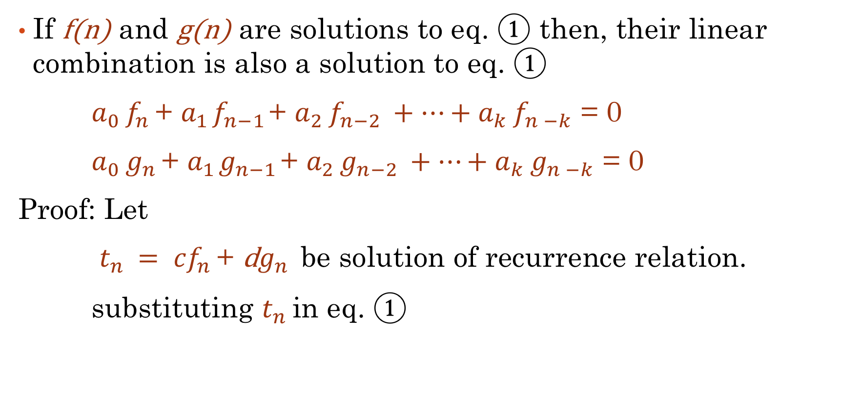
Property of Homogeneous Recurrences
If f(n) and g(n) are solutions to eq. $①$ then, their linear combination is also a solution to eq. $①$
$a_{0^{ }}f_{n^{ }}$+ $a_{1^{ }}f_{{n−1}^{ }}$+ $a_{2^{ }}f_{{n−2}^{ }}+…+a_{k^{ }}f_{n^{ }−k}$ = 0
$a_{0^{ }}g_{n^{ }}$+ $a_{1^{ }}g_{{n−1}^{ }}$+ $a_{2^{ }}g_{{n−2}^{ }}+…+a_{k^{ }}g_{n^{ }−k}$ = 0
Proof: Let
$t_{n^{ }}= {cf}_{n^{ }}$+ d$g_{n^{ }}$ be solution of recurrence relation.
substituting $t_{n^{ }}$in eq. $①$

Slide 13
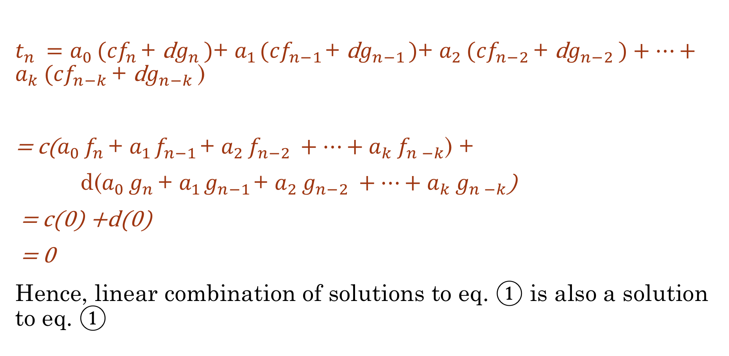
Property of Homogeneous Recurrences
$t_{n^{ }}=a_{0^{ }}({cf}_{n^{ }}\text{+ }\text{d}g_{n^{ }})$+ $a_{1^{ }}({cf}_{{n−1}^{ }}\text{+ }\text{d}g_{{n−1}^{ }})$+ $a_{2^{ }}({cf}_{{n−2}^{ }}\text{+ }\text{d}g_{{n−2}^{ }})+…+a_{k^{ }}({cf}_{{n−k}^{ }}\text{+ }\text{d}g_{{n−k}^{ }}$)
= c($a_{0^{ }}f_{n^{ }}$+ $a_{1^{ }}f_{{n−1}^{ }}$+ $a_{2^{ }}f_{{n−2}^{ }}+…+a_{k^{ }}f_{n^{ }−k}$) +
d($a_{0^{ }}g_{n^{ }}$+ $a_{1^{ }}g_{{n−1}^{ }}$+ $a_{2^{ }}g_{{n−2}^{ }}+…+a_{k^{ }}g_{n^{ }−k}$)
= c(0) +d(0)
= 0
Hence, linear combination of solutions to eq. $①$ is also a solution to eq. $①$

Slide 14

Homogeneous Recurrences
To find solution of eq. $①$ homogeneous recurrence
Let $t_{n^{ }}=$ $x^{n}$
So, substituting in eq. $①$
$a_{0^{ }}x^{n}$+ $a_{1^{ }}x^{n−1}$+ $a_{2^{ }}x^{n−2}+…+a_{k^{ }}x^{n−k}$= 0

Slide 15
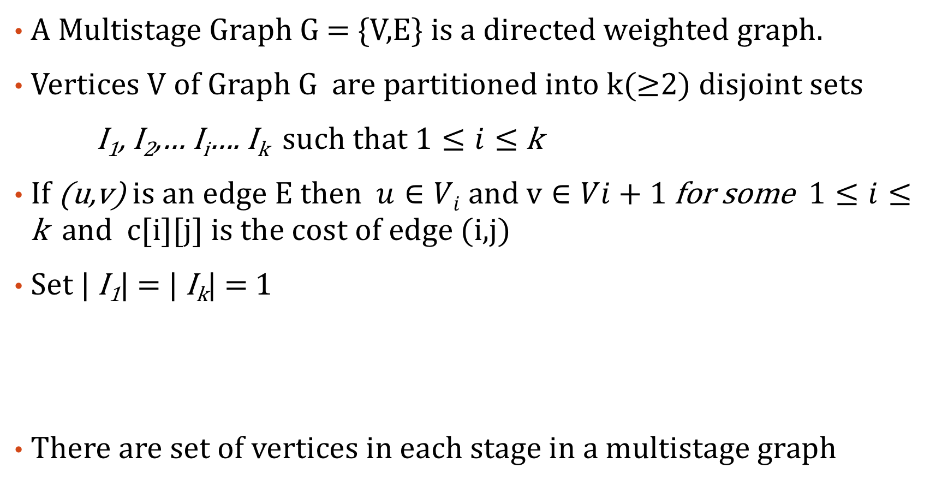
Multistage Graph
A Multistage Graph G = {V,E} is a directed weighted graph.
Vertices V of Graph G are partitioned into k(≥2) disjoint sets
I₁, I₂,… I_{i}…. I_{k} such that $1≤i≤$ k
If (u,v) is an edge E then $u∈Vi$and $v∈Vi+1$for some $1≤i≤$ k and c[i][j] is the cost of edge (i,j)
Set | I₁| = | I_{k}| = 1
There are set of vertices in each stage in a multistage graph
Source Vertex(S)
Sink Vertex(T)

Slide 16
Multistage Graph
Cost of path from S to T is calculated as the sum of weights along the edge on the path.
The multistage graph problem is to find minimum cost path from a given source node to destination node.
The minimum path in multistage graph is obtained by taking the minimum path at each current stage by considering the path length of each vertex obtained in earlier stage.
The multistage graph problem holds the principle of optimality.
Application: used to represent resource allocation

Slide 17
Multistage Graph
Use Recurrence Formula:
If cost[i][j] is cost of path from vertex j in stage I to destination vertex T, then cost of each vertex on every stage can be calculated using following recurrence formula.
$$cost\left[i\right]\left[j\right]=c\left[j\right]\left[intermediate\right]+cost\left[i+1\right][intermediate]$$
OR
$cost\left[i\right]\left[j\right]=$min{$c\left[j\right]\left[intermediate\right]+cost\left[i+1\right][intermediate]$}

Slide 18
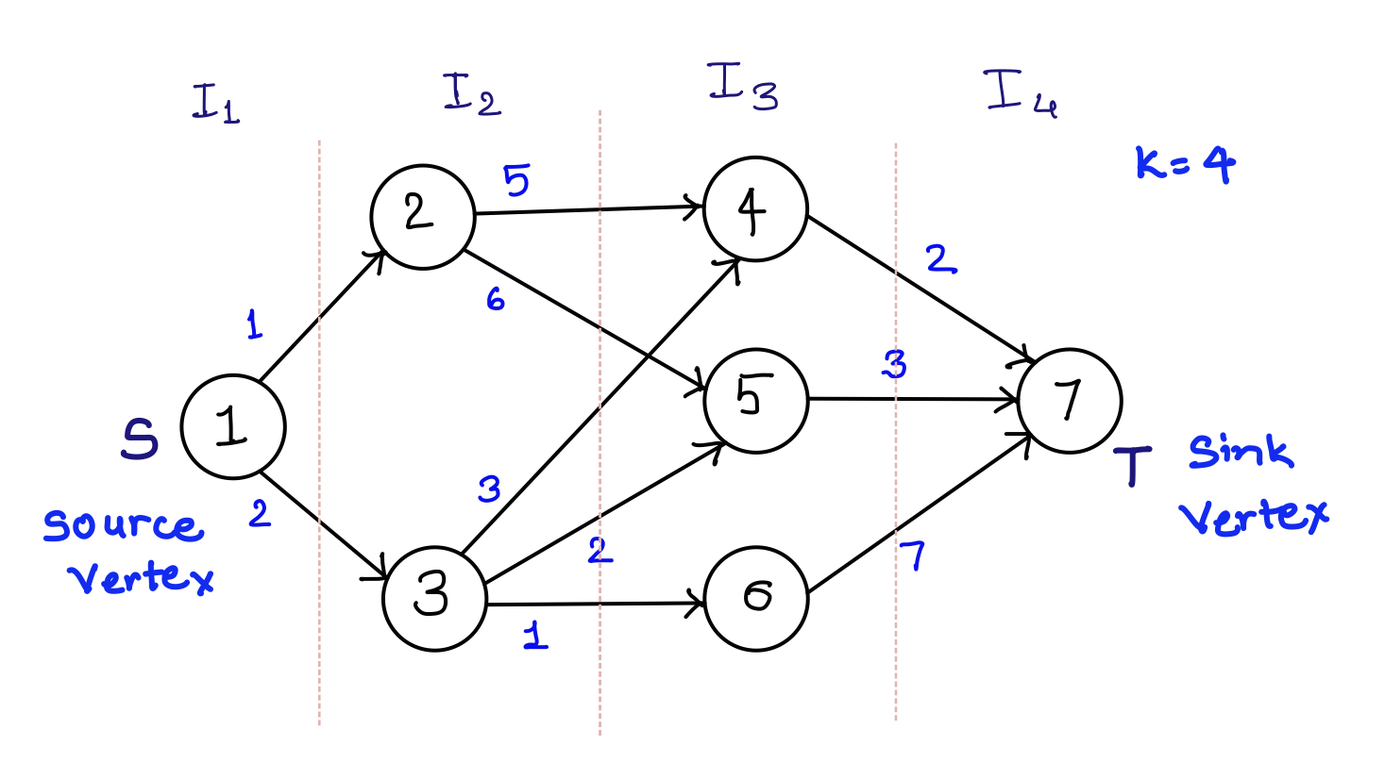
Multistage Graph: Example

Slide 19
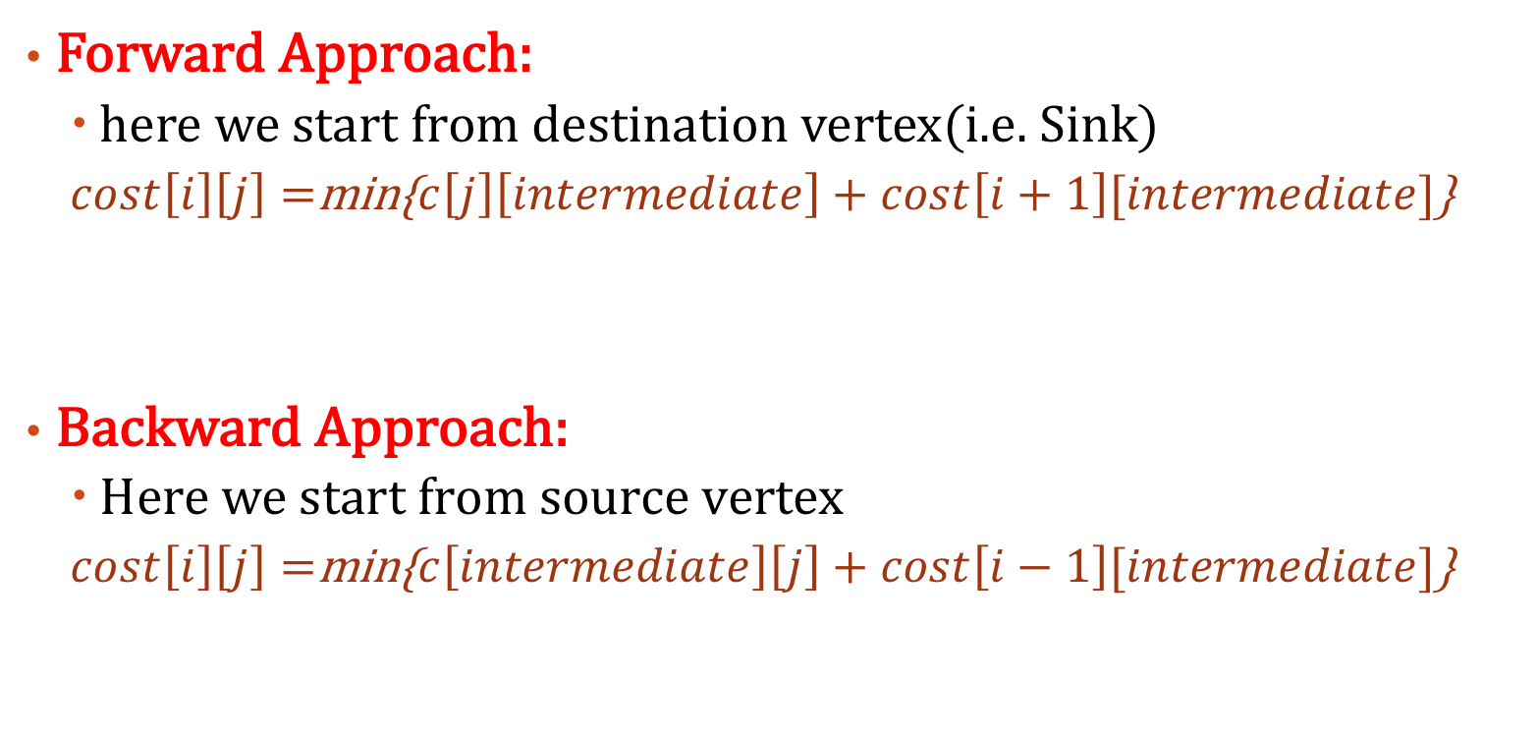
Multistage Graph: Methods to Solve
Forward Approach:
here we start from destination vertex(i.e. Sink)
$cost\left[i\right]\left[j\right]=$min{$c\left[j\right]\left[intermediate\right]+cost\left[i+1\right][intermediate]$}
Backward Approach:
Here we start from source vertex
$cost\left[i\right]\left[j\right]=$min{$c\left[intermediate\right]\left[j\right]+cost\left[i−1\right][intermediate]$}

Slide 20
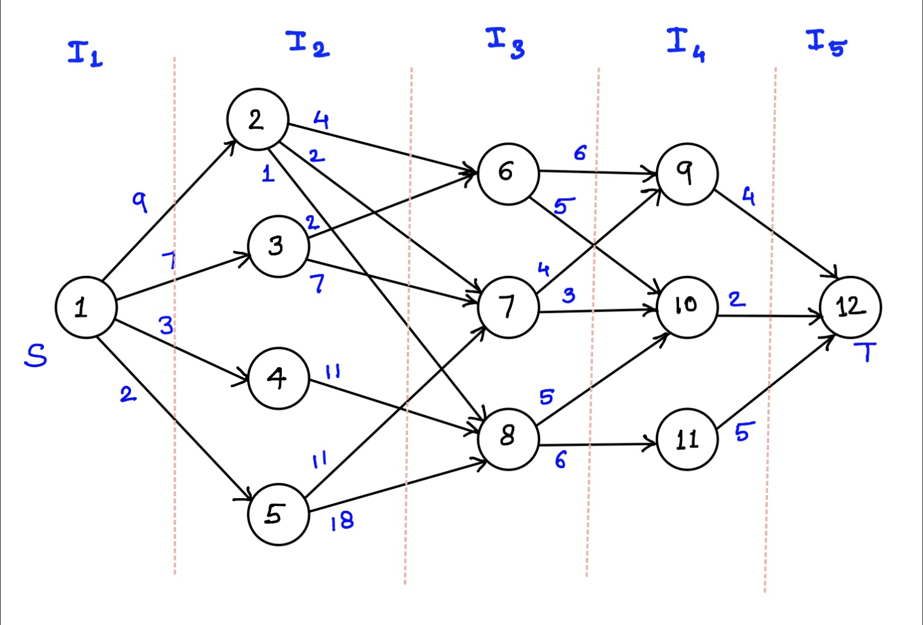
Multistage Graph: (Forward Approach)
Vertex | 1 | 2 | 3 | 4 | 5 | 6 | 7 | 8 | 9 | 10 | 11 | 12
cost |  |  |  |  |  |  |  |  |  |  |  | 0
d

Slide 21
Multistage Graph: (Forward Approach)
Stage 5:
i=5; Vertices(j) = {12}
cost[5][12]=0
Stage 4:
i=4; vertices(j) ={9,10,11}
cost[4][9]= c[9][12]+cost[5][12]
cost[4][9]=(4+0)=4
Similarly, cost[4][10] = 2
cost[4][11]=5
Stage 3:
i=3; Vertices(j) = {6,7,8}
cost[3][6]=min{(c[6][9] + cost [4][9]), (c[6][10] + cost [4][10])}
=min{(6+4),(5+2)} = 7
cost[3][7]= min{(c[7][9] + cost [4][9]), (c[7][10] + cost [4][10])}
=min{(4+4),(3+2)} = 5
cost[3][8]=min{(c[8][10] + cost [4][10]),(c[8][11] + cost [4][11])}
=min{(5+2),(6+5)} = 7
Vertex | 1 | 2 | 3 | 4 | 5 | 6 | 7 | 8 | 9 | 10 | 11 | 12
cost |  |  |  |  |  | 7 | 5 | 7 | 4 | 2 | 5 | 0
d |  |  |  |  |  | 10 | 10 | 10 | 12 | 12 | 12 | 12

Slide 22
Multistage Graph: (Forward Approach)
Stage 2:
i=2; Vertices(j) = {2, 3, 4, 5}
cost[2][2]=min{(c[2][6] + cost [3][6]), (c[2][7] + cost [3][7]), (c[2][8] + cost [3][8]) }
=min{(4+7), (2+5), (1+7)} = min{11,7,8} = 7
cost[2][3]= min{(c[3][6] + cost [3][6]), (c[3][7] + cost [3][7])}
=min{(2+7),(7+5)} = min{9,11} = 9
cost[2][4]=min{(c[4][8] + cost [3][8]) }
=min{(11+7)} = 18
cost[2][5]=min{(c[5][7] + cost [3][7]),(c[5][8] + cost [3][8])}
=min{(11+5),(8+7)} = min{16,15} = 15
Stage 1:
i=1; Vertices(j) = {1}= Source
cost[1][1] = min{(c[1][2] + cost [2][2]), (c[1][3] + cost [2][3]),
(c[1][4] + cost [2][4]),
(c[1][5] + cost [2][5])}
= min{(9+7), (7+9), (3+18) +(2+15)}
= min{16, 16, 21, 17} = 16
Vertex | 1 | 2 | 3 | 4 | 5 | 6 | 7 | 8 | 9 | 10 | 11 | 12
cost | 16 | 7 | 9 | 18 | 15 | 7 | 5 | 7 | 4 | 2 | 5 | 0
d | 2 or 3 | 7 | 6 | 8 | 8 | 10 | 10 | 10 | 12 | 12 | 12 | 12

Slide 23
Multistage Graph: (Forward Approach)
Shortest Path 1:
1 – 2 – 7 – 10 – 12
Shortest Path 2:
1 – 3 – 6 – 10 – 12
Vertex | 1 | 2 | 3 | 4 | 5 | 6 | 7 | 8 | 9 | 10 | 11 | 12
cost | 16 | 7 | 9 | 18 | 15 | 7 | 5 | 7 | 4 | 2 | 5 | 0
d | 2 or 3 | 7 | 6 | 8 | 8 | 10 | 10 | 10 | 12 | 12 | 12 | 12

Slide 24
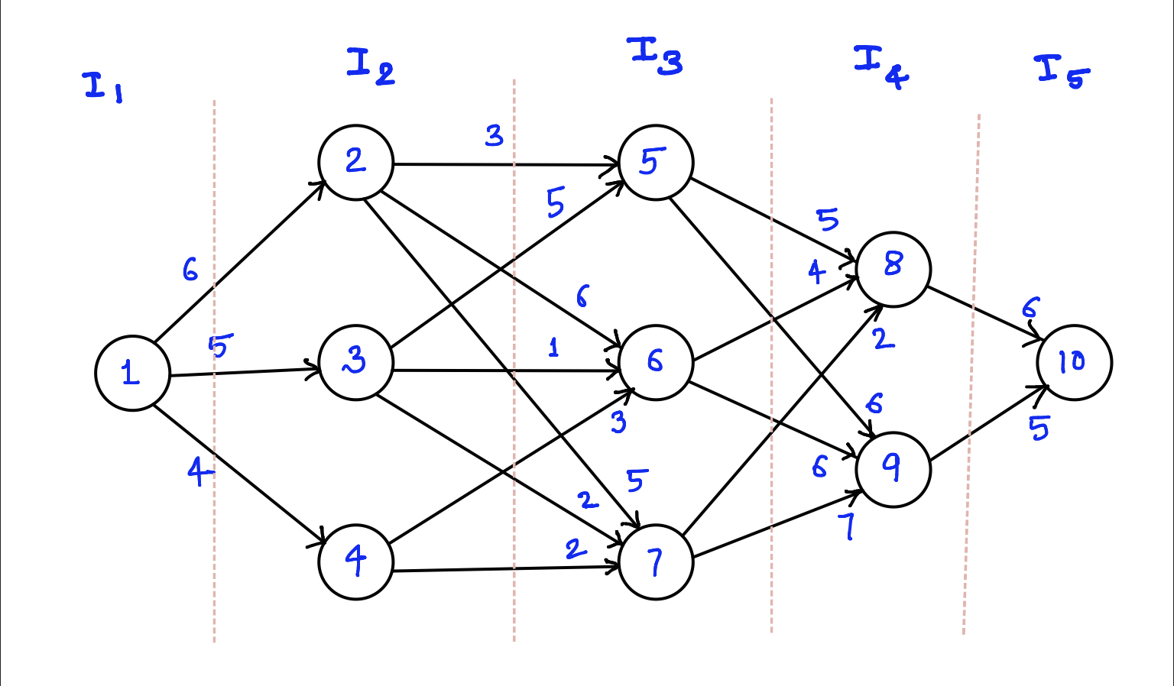
Multistage Graph: (Backward Approach)
Vertex | 1 | 2 | 3 | 4 | 5 | 6 | 7 | 8 | 9 | 10
cost
d

Slide 25
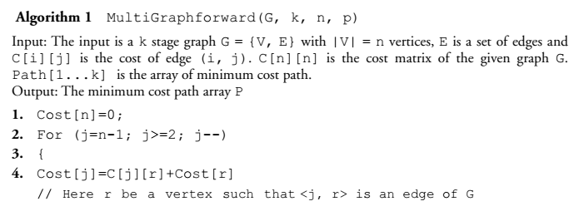
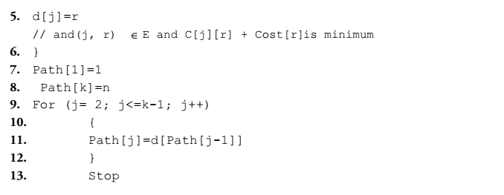
Algorithm: (Forward Approach)

Slide 26
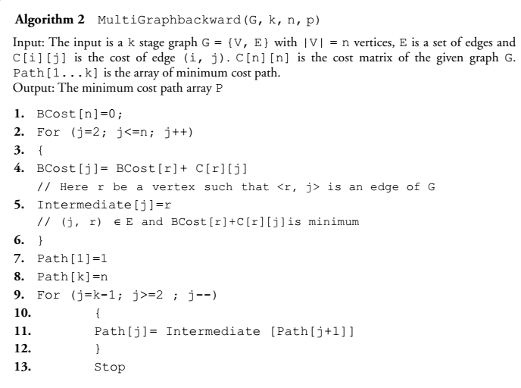
Algorithm: (Backward Approach)

Slide 27
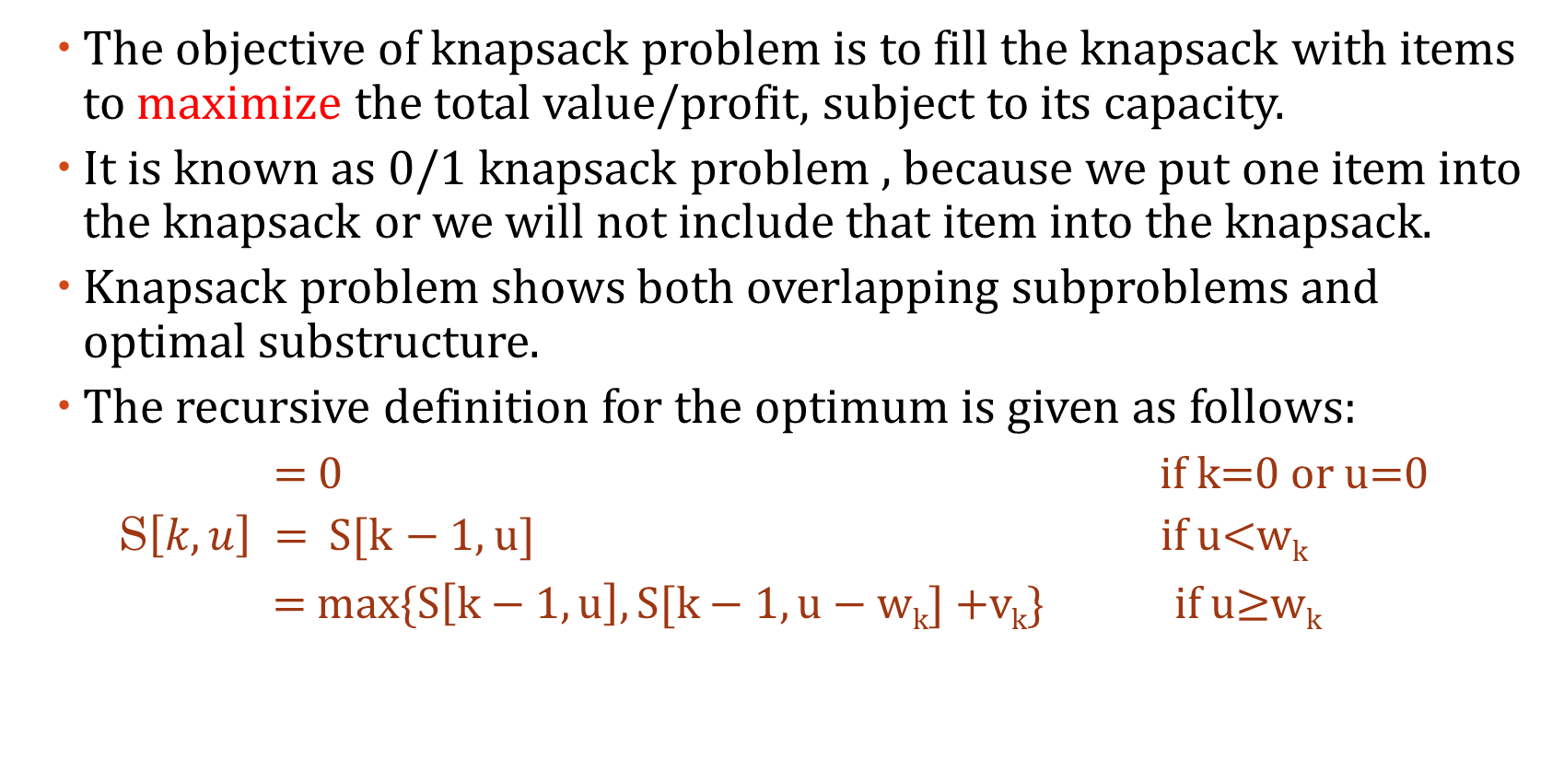
0/1 Knapsack Problem
The objective of knapsack problem is to fill the knapsack with items to maximize the total value/profit, subject to its capacity.
It is known as 0/1 knapsack problem , because we put one item into the knapsack or we will not include that item into the knapsack.
Knapsack problem shows both overlapping subproblems and optimal substructure.
The recursive definition for the optimum is given as follows:
= 0 if k=0 or u=0
S$\left[k,u\right] =$ S[k $−$1, u] if u<w_{k}
= max{S$\left[k−1, u\right], S[k−1,u−\text{w}\text{k}]+$v_{k}} if u≥w_{k}

Slide 28
0/1 Knapsack Problem: Example
Item (k) | 1 | 2 | 3 | 4
Weight(w_{k}) | 2 | 3 | 4 | 5
Value(v_{k}) | 4 | 8 | 9 | 11
W = 5
Weight(u) $→$
0 | 1 | 2 | 3 | 4 | 5
Item(k)
0
1
2
3
4

Slide 29
0/1 Knapsack Problem: Example
Weight(u) $→$
0 | 1 | 2 | 3 | 4 | 5
Step 1: k = 0; u = {0…5}
k=0 , u = 0
S[k,u] = 0 for u={1,2,3,4,5}
Item(k)
0
1
2
3
4
0 | 0 | 0 | 0 | 0 | 0

Slide 30
0/1 Knapsack Problem: Example
Step 2: k = 1; u = {0…5}
k=1, w₁=2, u = 0;
u<w_{1,}
S[k,u] = S[k-1,u]
S[1,0] = S[0,0] = 0
Step 2: k = 1; u = {0…5}
k=1, w₁=2, u = 3;
u>w_{1,}
S[k,u] = max{S[k-1,u], S[k-1, u-w_{k}] + v_{k}}
S[1,3] = max{S[0,3], S[0,1] + 4} = max{0,0+4} = 4
Step 2: k = 1; u = {0…5}
k=1, w₁=2, u = 1;
u<w_{1,}
S[k,u] = S[k-1,u]
S[1,1] = S[0,1] = 0
Step 2: k = 1; u = {0…5}
k=1, w₁=2, u = 4;
u>w_{1,}
S[k,u] = max{S[k-1,u], S[k-1, u-w_{k}] + v_{k}}
S[1,4] = max{S[0,4], S[0,2] + 4} = max{0,0+4} = 4
Step 2: k = 1; u = {0…5}
k=1, w₁=2, u = 2;
u=w_{1,}
S[k,u] = max{S[k-1,u], S[k-1, u-w_{k}] + v_{k}}
S[1,2] = max{S[0,2], S[0, 0] + 4} = max{0,0+4} = 4
Step 2: k = 1; u = {0…5}
k=1, w₁=2, u = 5;
u>w_{1,}
S[k,u] = max{S[k-1,u], S[k-1, u-w_{k}] + v_{k}}
S[1,5] = max{S[0,5], S[0,3] + 4} = max{0,0+4} = 4

Slide 31
0/1 Knapsack Problem: Example
Weight(u) $→$
0 | 1 | 2 | 3 | 4 | 5
0 | 0 | 0 | 0 | 0 | 0
Item(k)
0
1
2
3
4
0 | 0 | 4 | 4 | 4 | 4

Slide 32
0/1 Knapsack Problem: Example
Step 3: k = 2; u = {0…5}
k=2, w₂=3, u = 0;
u<w_{2,}
S[k,u] = S[k-1,u]
S[2,0] = S[1,0] = 0
Step 3: k = 2; u = {0…5}
k=2, w₂=3, u = 3;
u=w_{1,}
S[k,u] = max{S[k-1,u], S[k-1, u-w_{k}] + v_{k}}
S[2,3] = max{S[1,3], S[1,0] + 8} = max{4,0+8} = 8
Step 3: k = 2; u = {0…5}
k=2, w₂=3, u = 1;
u<w_{2,}
S[k,u] = S[k-1,u]
S[2,1] = S[1,1] = 0
Step 3: k = 2; u = {0…5}
k=2, w₂=3, u = 4;
u>w_{1,}
S[k,u] = max{S[k-1,u], S[k-1, u-w_{k}] + v_{k}}
S[2,4] = max{S[1,4], S[1,1] + 8} = max{4,0+8} = 8
Step 3: k = 2; u = {0…5}
k=2, w₂=3, u = 2;
u<w_{2,}
S[k,u] = S[k-1,u]
S[2,2] = S[1,2]= 4
Step 3: k = 2; u = {0…5}
k=2, w₂=3, u = 5;
u>w_{1,}
S[k,u] = max{S[k-1,u], S[k-1, u-w_{k}] + v_{k}}
S[2,5] = max{S[1,5], S[1,2] + 8} = max{4,4+8} = 12

Slide 33
0/1 Knapsack Problem: Example
Weight(u) $→$
0 | 1 | 2 | 3 | 4 | 5
0 | 0 | 0 | 0 | 0 | 0
0 | 0 | 4 | 4 | 4 | 4
Item(k)
0
1
2
3
4
0 | 0 | 4 | 8 | 8 | 12

Slide 34
0/1 Knapsack Problem: Example
Step 4: k = 3; u = {0…5}
k=3, w₃=4, u = 0;
u<w_{3,}
S[k,u] = S[k-1,u]
S[3,0] = S[2,0] = 0
Step 4: k = 3; u = {0…5}
k=3, w₃=4, u = 3;
u<w_{3,}
S[k,u] = S[k-1,u]
S[3,3] = S[2,3] = 8
Step 4: k = 3; u = {0…5}
k=3, w₃=4, u = 1;
u<w_{3,}
S[k,u] = S[k-1,u]
S[3,1] = S[2,1] = 0
Step 4: k = 3; u = {0…5}
k=3, w₃=4, u = 4;
u=w_{3,}
S[k,u] = max{S[k-1,u], S[k-1, u-w_{k}] + v_{k}}
S[3,4] = max{S[2,4], S[2,0] + 8} = max{8,0+9} = 9
Step 4: k = 3; u = {0…5}
k=3, w₃=4, u = 2;
u<w_{3,}
S[k,u] = S[k-1,u]
S[3,2] = S[2,2]= 4
Step 4: k = 3; u = {0…5}
k=3, w₃=4, u = 5;
u>w_{3,}
S[k,u] = max{S[k-1,u], S[k-1, u-w_{k}] + v_{k}}
S[3,5] = max{S[2,5], S[2,1] +11 } = max{12,0+11} = 12

Slide 35
0/1 Knapsack Problem: Example
Weight(u) $→$
0 | 1 | 2 | 3 | 4 | 5
0 | 0 | 0 | 0 | 0 | 0
0 | 0 | 4 | 4 | 4 | 4
0 | 0 | 4 | 8 | 8 | 12
Item(k)
0
1
2
3
4
0 | 0 | 4 | 8 | 9 | 12

Slide 36
0/1 Knapsack Problem: Example
Step 5: k = 4; u = {0…5}
k=4, w₄=5, u = 0;
u<w_{4,}
S[k,u] = S[k-1,u]
S[4,0] = S[3,0] = 0
Step 5: k = 4; u = {0…5}
k=4, w₄=5, u = 3;
u<w_{4,}
S[k,u] = S[k-1,u]
S[4,3] = S[3,3] = 8
Step 5: k = 4; u = {0…5}
k=4, w₄=5, u = 1;
u<w_{4,}
S[k,u] = S[k-1,u]
S[4,1] = S[3,1] = 0
Step 5: k = 4; u = {0…5}
k=4, w₄=5, u = 4;
u<w_{4,}
S[k,u] = S[k-1,u]
S[4,4] = S[3,4] = 9
Step 5: k =4; u = {0…5}
k=4, w₄=5, u = 2;
u<w_{4,}
S[k,u] = S[k-1,u]
S[4,2] = S[3,2]= 4
Step 5: k = 4; u = {0…5}
k=4, w₄=5, u = 5;
u=w_{4,}
S[k,u] = max{S[k-1,u], S[k-1, u-w_{k}] + v_{k}}
S[4,5] = max{S[3,5], S[3,0] +11 } = max{12,0+11} = 12

Slide 37
0/1 Knapsack Problem: Example
Weight(u) $→$
0 | 1 | 2 | 3 | 4 | 5
0 | 0 | 0 | 0 | 0 | 0
0 | 0 | 4 | 4 | 4 | 4
0 | 0 | 4 | 8 | 8 | 12
0 | 0 | 4 | 8 | 9 | 12
Item(k)
0
1
2
3
4
optimal profit of the given knapsack problem is 12
0 | 0 | 4 | 8 | 9 | 12

Slide 38
0/1 Knapsack Problem
To find the items of the optimal cost:
Rajesh K. Shukla. Analysis and Design of Algorithms: A Beginner's Approach (Page 240).
1 | if S[k][u] ≠ S[k - 1][u], | //S[k][u] and S[k - 1][u] are different
2 | then, k^{th} item is selected i.e. | //k=n and u=W(Capacity of Knapsack)
3 | print k and set u = u—w_{k}
4 | k = k—1
5 | if S[k][u] = S[k - 1][u] then,
6 | set k = k—1

Slide 39
0/1 Knapsack Problem: Example
S[4][5]= S[3][5]
So, k=4-1=3
Weight(u) $→$
0 | 1 | 2 | 3 | 4 | 5
0 | 0 | 0 | 0 | 0 | 0
0 | 0 | 4 | 4 | 4 | 4
0 | 0 | 4 | 8 | 8 | 12
0 | 0 | 4 | 8 | 9 | 12
Item(k)
0
1
2
3
4
S[3][5]= S[2][5]
So, k=3-1=2
S[2][5]≠ S[1][5]
So, k=2-1=1 & u=u-w₂ =5-3=2
S[1][2]≠ S[0][2]
So, k=1-1=0 & u=u-w₂ =2-2=0
I={1,2,3,4}
I={0,0,0,0}
0 | 0 | 4 | 8 | 9 | 12
I={0,0,0,0}
I={0,1,0,0}
optimal profit
I={1,1,0,0}

Slide 40
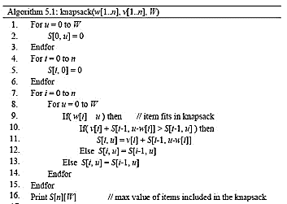
0/1 Knapsack Problem: Algorithm
<=

Slide 41
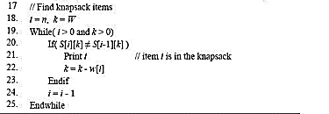
0/1 Knapsack Problem: Algorithm

Slide 42
All Pair Shortest Path
Floyd-Warshall Algorithm:
Floyd’s Algorithm is for finding shortest path between every pair of vertices of a graph.
Works for both directed and undirected graph.
The graph may contain negative edges, but it should not contain negative cycles.
Floyd’s algorithm requires a weighted graph
Floyd’s algorithm computes distance matrix of weighted graph.
It takes dynamic programming approach and runs in O(n³) times.

Slide 43
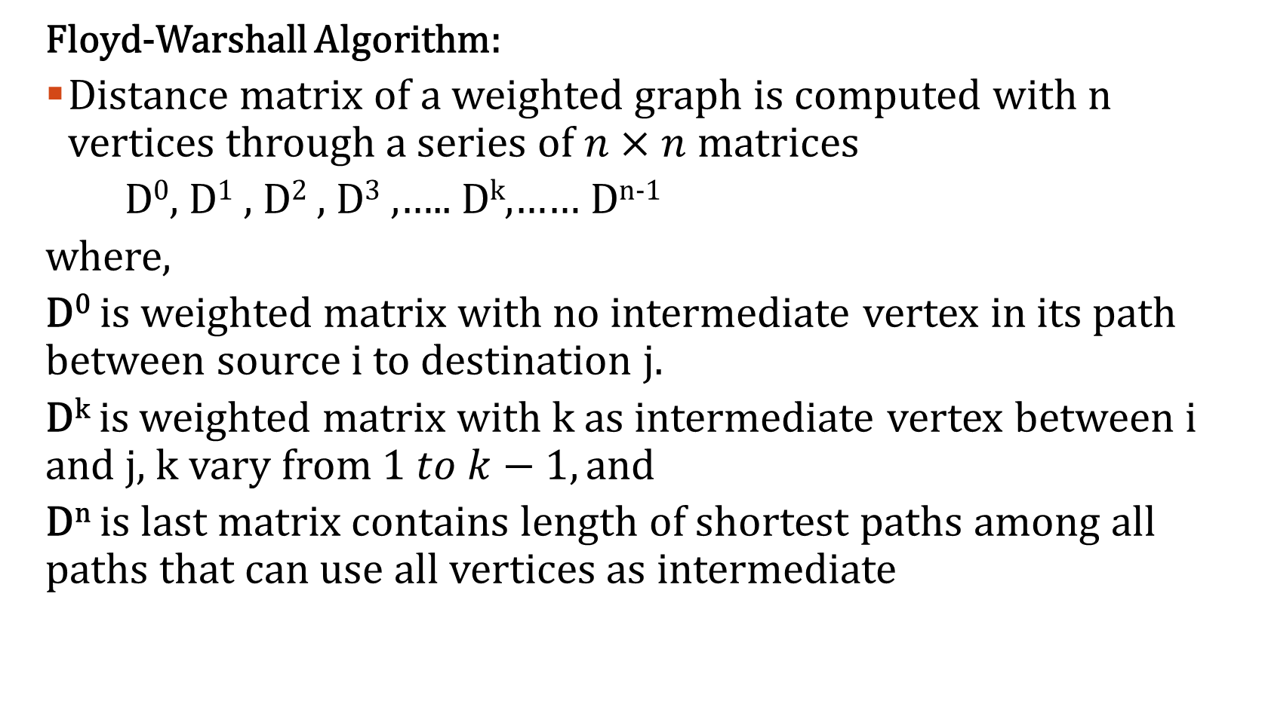
All Pair Shortest Path
Floyd-Warshall Algorithm:
Distance matrix of a weighted graph is computed with n vertices through a series of$n×n$ matrices
D⁰, D¹ , D² , D³ ,….. D^{k},…… D^{n-1}
where,
D⁰ is weighted matrix with no intermediate vertex in its path between source i to destination j.
D^{k} is weighted matrix with k as intermediate vertex between i and j, k vary from $1 to k−1, and$
D^{n} is last matrix contains length of shortest paths among all paths that can use all vertices as intermediate

Slide 44
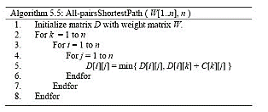
All Pair Shortest Path: Algorithm
Floyd-Warshall Algorithm:
Recursive formula:
D^{k}[i][j] = min{D^{k-1}[i][j], D^{k-1}[i][k]+ D^{k-1}[k][j]}
Here, old values of D^{k-1} is overwritten by new values of D^{k}

Slide 45
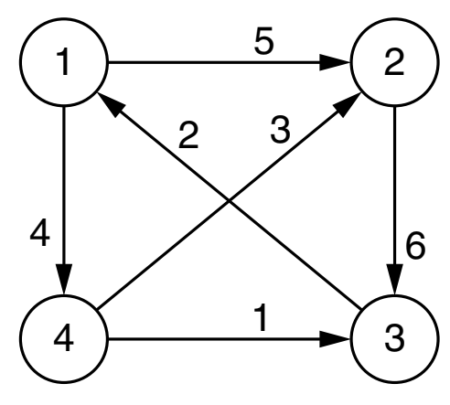
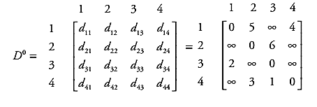
All Pair Shortest Path: Example
Floyd-Warshall Algorithm:
Recursive formula:
D^{k}[i][j] = min{D^{k-1}[i][j], D^{k-1}[i][k]+ D^{k-1}[k][j]}
Here, old values of D^{k-1} is overwritten by new values of D^{k}

Slide 46
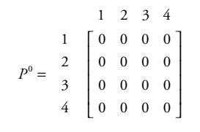
All Pair Shortest Path: Example
Floyd-Warshall Algorithm:
Path matrix P is also initialized to NULL (0) entries.

Slide 47
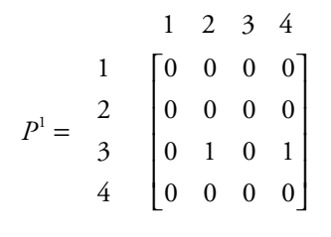
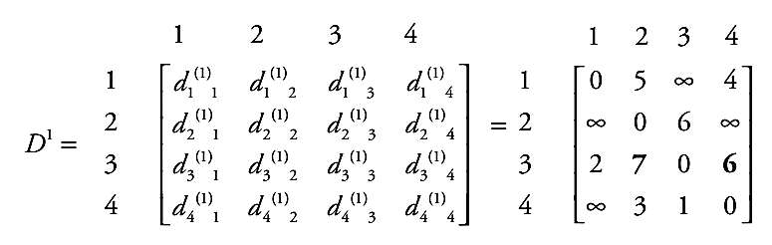
All Pair Shortest Path: Example
D¹ : Node 1 as intermediate node
Floyd-Warshall Algorithm:

Slide 48
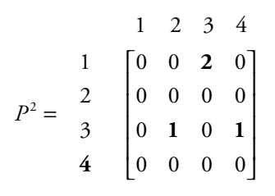
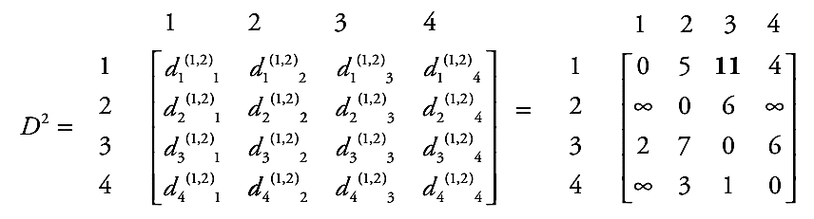
All Pair Shortest Path: Example
Floyd-Warshall Algorithm:
D² : Node 2 as intermediate node

Slide 49
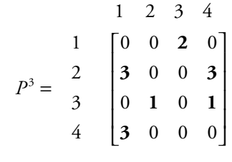
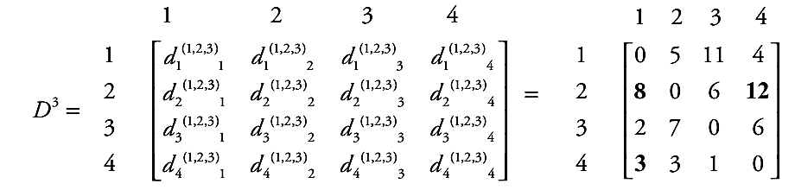
All Pair Shortest Path: Example
Floyd-Warshall Algorithm:
D³ : Node 3 as intermediate node

Slide 50
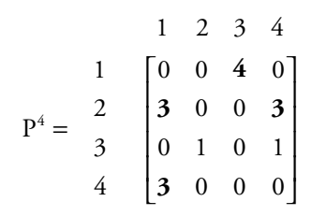
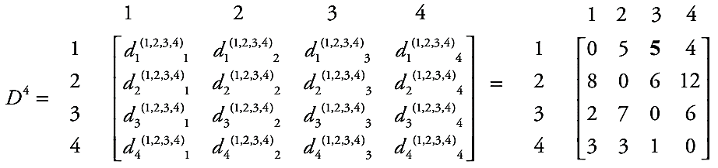
All Pair Shortest Path: Example
D⁴ : Node 4 as intermediate node

Slide 51
Single Source Shortest Path
Bellman Ford Algorithm:
If graph has negative edge cost, then Dijkstra’s Algorithm does not work.
Bellman ford proposed an algorithm, which is combination of Dijkstra’s algorithm and unweighted algorithms.
Slower than Dijkstra’s but more versatile.
If there exists negative cycle in a graph, then there will be no shortest path.
Relaxation Formula:
If (d[v]> d[u]+cost[u,v])
then, d[v]= d[u]+cost[u,v]

Slide 52
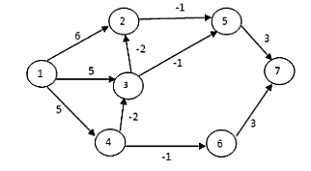
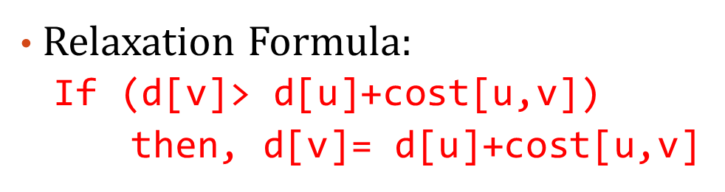
Single Source Shortest Path
Bellman Ford Algorithm: Example
EdgeList={(1,2), (1,3), (1,4), (4,3), (3,2), (2,5), (3,5), (4,6), (5,7), (6,7) }
1

Slide 53
Single Source Shortest Path
Bellman Ford Algorithm: Example
EdgeList={(1,2), (1,3), (1,4), (4,3), (3,2), (2,5), (3,5), (4,6), (5,7), (6,7) }
 |  | 1 | 2 | 3 | 4 | 5 | 6 | 7
Initialization | 0 | 0 | ∞ | ∞ | ∞ | ∞ | ∞ | ∞
k= | 1 | 0 | 6 | 5 | 5 | ∞ | ∞ | ∞
 | 2 | 0 | 3 | 3 | 5 | 5 | 4 | ∞
 | 3 | 0 | 1 | 3 | 5 | 2 | 4 | 5
 | 4 | 0 | 1 | 3 | 5 | 0 | 4 | 3
 | 5 | 0 | 1 | 3 | 5 | 0 | 4 | 3
 | 6 | 0 | 1 | 3 | 5 | 0 | 4 | 3
Path Length (k) = |V|-1 = 7-1 = 6

Slide 54
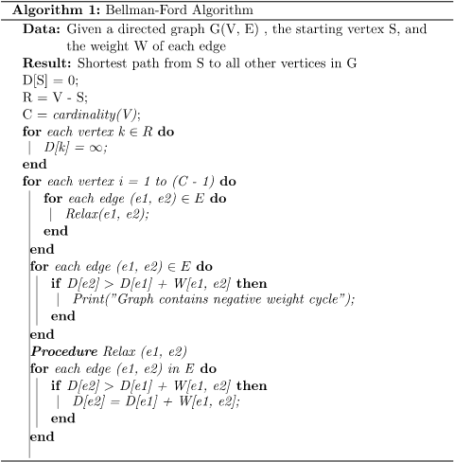
Single Source Shortest Path
Bellman Ford Algorithm:

Slide 55
The Travelling Salesman Problem
Trying all the possibilities – Brute Force Approach.
There are n cities
Salesman has to visit all cities, starting from a city.
He is not allowed to visit any city more than once and come back to starting city.
Cost of travelling cities is given.
We have to find tour of salesman with lowest cost.

Slide 56
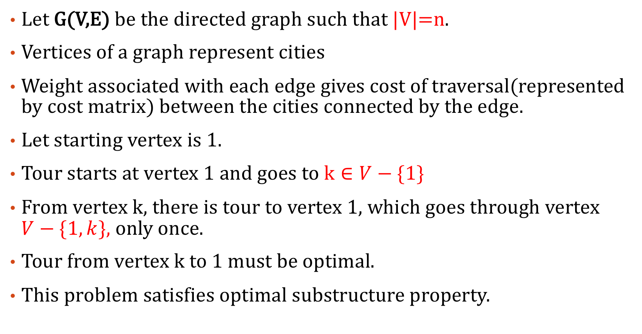
The Travelling Salesman Problem
Let G(V,E) be the directed graph such that |V|=n.
Vertices of a graph represent cities
Weight associated with each edge gives cost of traversal(represented by cost matrix) between the cities connected by the edge.
Let starting vertex is 1.
Tour starts at vertex 1 and goes to $k∈V−\{1\}$
From vertex k, there is tour to vertex 1, which goes through vertex $V−\{1, k\}$, only once.
Tour from vertex k to 1 must be optimal.
This problem satisfies optimal substructure property.

Slide 57
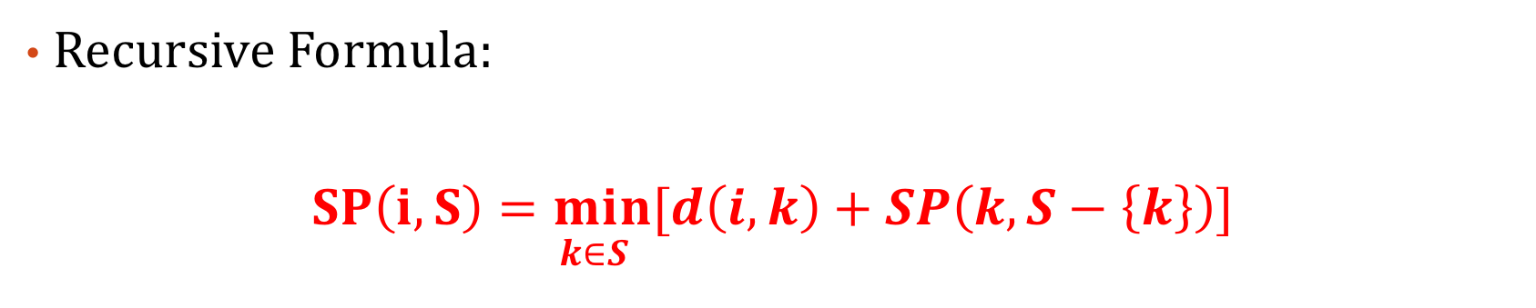
The Travelling Salesman Problem
Recursive Formula:
$$\underset{ k∈S}{SP\left(i,S\right)=min}{[d\left(i,k\right)+SP\left(k,S−\left\{k\right\}\right)]}$$
where,
V= set of all vertices
S = set of remaining or unvisited vertices →subset of V
i = source vertex
k = intermediate vertex
and, SP(i, S) = shortest path from i to all other unvisited vertices.

Slide 58
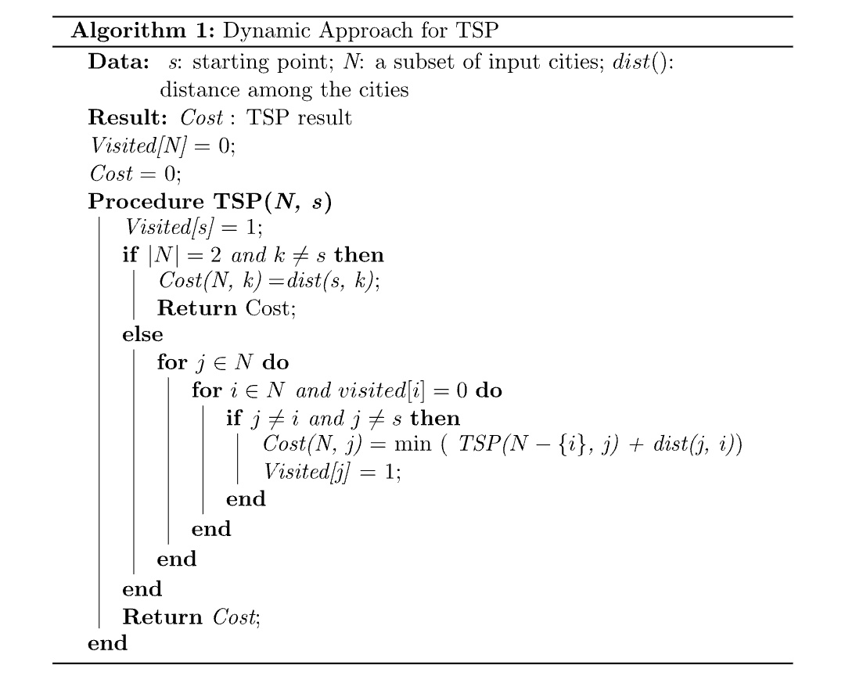
The Travelling Salesman Problem
Algorithm:

Slide 59
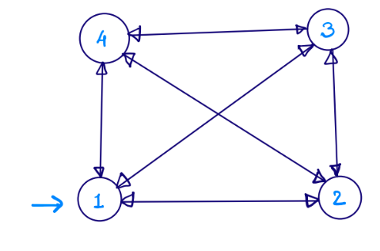
The Travelling Salesman Problem
Example:
1 | 2 | 3 | 4
1
2
3
4
0 | 5 | 10 | 15
6 | 0 | 8 | 12
8 | 10 | 0 | 14
7 | 9 | 20 | 0
Directed Graph
Cost Matrix

Slide 60
The Travelling Salesman Problem
1
Level 4 → S{2,3,4}
2
3
4
Level 3→ S{2,3}, S{3,2} etc.
3
4
2
4
2
3
Level 2 → S{2}, S{3} or S{4}
4
3
4
2
3
2
Level 1 → S=$∅$
1
1
1
1
1
1

Slide 61
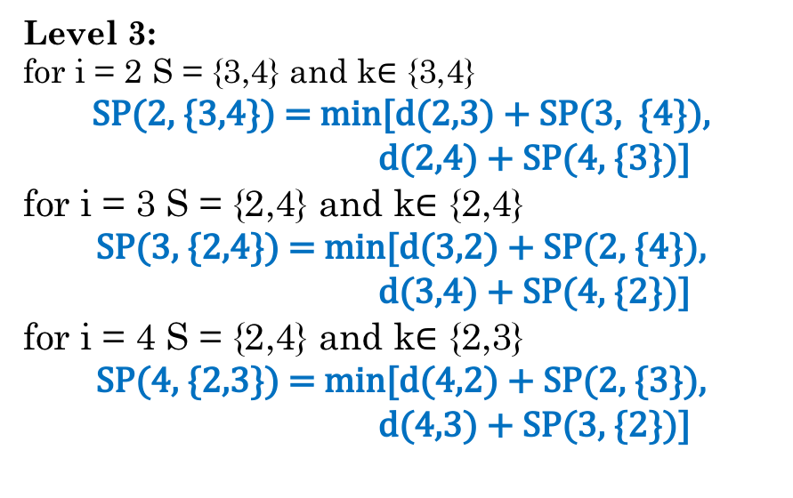
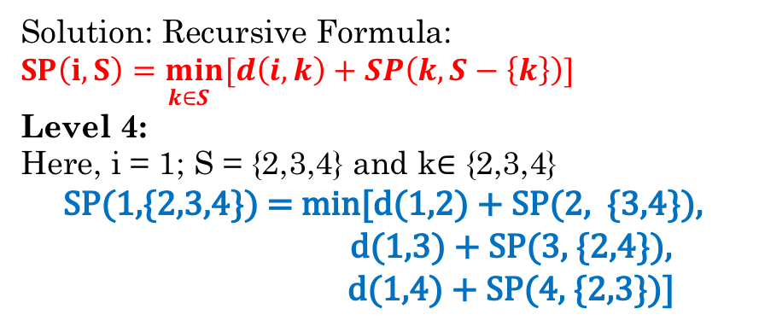
The Travelling Salesman Problem
Solution: Recursive Formula: $\underset{ k∈S}{SP\left(i,S\right)=min}{[d\left(i,k\right)+SP\left(k,S−\left\{k\right\}\right)]}$
Level 4:
Here, i = 1; S = {2,3,4} and k$∈$ {2,3,4}
SP(1,{2,3,4}) = min[d(1,2) + SP(2, {3,4}),
d(1,3) + SP(3, {2,4}),
d(1,4) + SP(4, {2,3})]
Terms SP(2, {3,4}), SP(3, {2,4}), SP(4, {2,3}) are unknow for now
Level 3:
for i = 2 S = {3,4} and k$∈$ {3,4}
SP(2, {3,4}) = min[d(2,3) + SP(3, {4}),
d(2,4) + SP(4, {3})]
for i = 3 S = {2,4} and k$∈$ {2,4}
SP(3, {2,4}) = min[d(3,2) + SP(2, {4}),
d(3,4) + SP(4, {2})]
for i = 4 S = {2,4} and k$∈$ {2,3}
SP(4, {2,3}) = min[d(4,2) + SP(2, {3}),
d(4,3) + SP(3, {2})]
Terms SP(3, {4}), SP(4, {3}), SP(2, {4}), SP(4, {2}), SP(2,{3}) and SP(3,{2}) are unknow for now

Slide 62
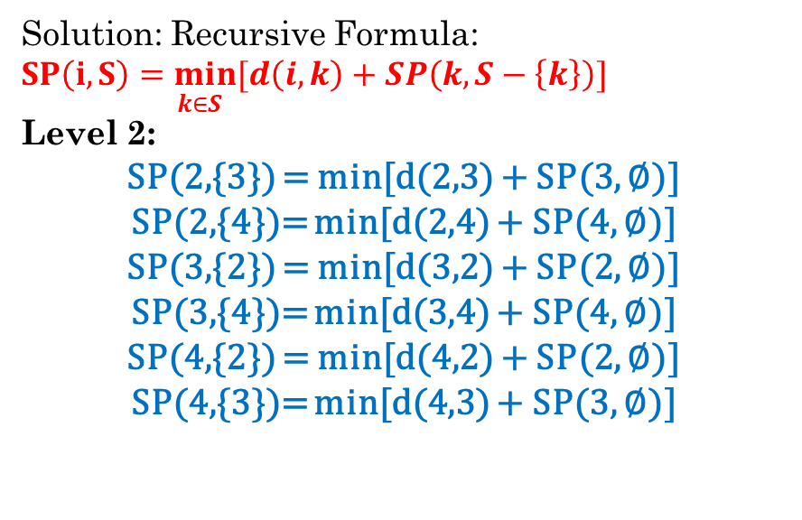
The Travelling Salesman Problem
Solution: Recursive Formula: $\underset{ k∈S}{SP\left(i,S\right)=min}{[d\left(i,k\right)+SP\left(k,S−\left\{k\right\}\right)]}$
Level 2:
SP(2,{3}) = min[d(2,3) + SP(3, ∅)]
SP(2,{4})= min[d(2,4) + SP(4, ∅)]
SP(3,{2}) = min[d(3,2) + SP(2, ∅)]
SP(3,{4})= min[d(3,4) + SP(4, ∅)]
SP(4,{2}) = min[d(4,2) + SP(2, ∅)]
SP(4,{3})= min[d(4,3) + SP(3, ∅)]
Level 1:
SP(2, ∅) = d(2,1) = 6
SP(3, ∅) = d(3,1) = 8
SP(4, ∅) = d(4,1) = 7
Terms SP(2, ∅), SP(3, ∅), SP(4, ∅), are unknow for now
Substitute above values in previous levels

Slide 63
The Travelling Salesman Problem
Level 1:
SP(2, ∅) = d(2,1) = 6
SP(3, ∅) = d(3,1) = 8
SP(4, ∅) = d(4,1) = 7
Level 3:
SP(2, {3,4}) = min[d(2,3) + SP(3, {4}),
d(2,4) + SP(4, {3})]
= min[(8+21),(12+28)]=29
SP(3, {2,4}) = min[d(3,2) + SP(2, {4}),
d(3,4) + SP(4, {2})]
=min[(10+19),(14+15)]=29
SP(4, {2,3}) = min[d(4,2) + SP(2, {3}),
d(4,3) + SP(3, {2})]
=min[(9+16), (20+16)]=25
Substitute above values in previous levels
Level 2:
SP(2,{3}) = min[d(2,3) + SP(3, ∅)]=8+8=16
SP(2,{4})= min[d(2,4) + SP(4, ∅)]=12+7=19
SP(3,{2}) = min[d(3,2) + SP(2, ∅)] =10+6=16
SP(3,{4})= min[d(3,4) + SP(4, ∅)]=14+7=21
SP(4,{2}) = min[d(4,2) + SP(2, ∅)] =9+6=15
SP(4,{3})= min[d(4,3) + SP(3, ∅)]=20+8=28
Level 4:
SP(1,{2,3,4}) = min[d(1,2) + SP(2, {3,4}),
d(1,3) + SP(3, {2,4}),
d(1,4) + SP(4, {2,3})]
= min[(5+29), (10+29), (15+25)] = 34
1→2→3→4→1

Slide 64
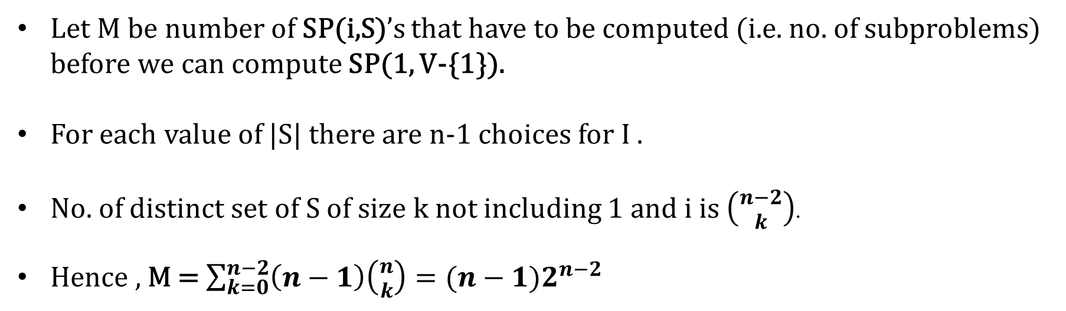
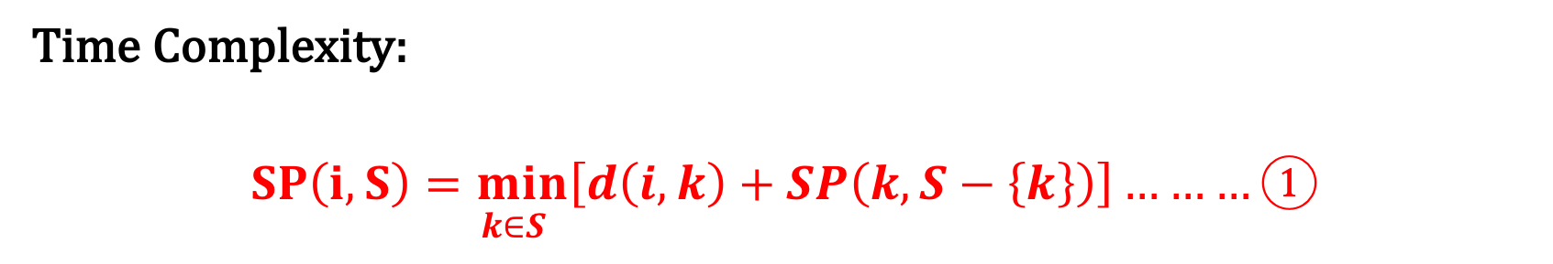
The Travelling Salesman Problem
Time Complexity:
$$\underset{ k∈S}{SP\left(i,S\right)=min}\left[d\left(i,k\right)+SP\left(k,S−\left\{k\right\}\right)\right]………①$$
Let M be number of SP(i,S)’s that have to be computed (i.e. no. of subproblems) before we can compute SP(1, V-{1}).
For each value of |S| there are n-1 choices for I .
No. of distinct set of S of size k not including 1 and i is $\left({n−2 \atop k}\right)$.
Hence , M = $\sum_{k=0}^{n−2}{\left(n−1\right)\left({n \atop k}\right)=(n−1)2^{n−2}}$

Slide 65
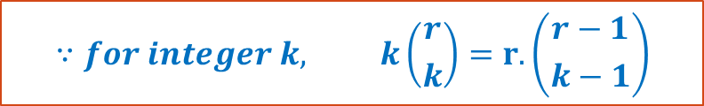
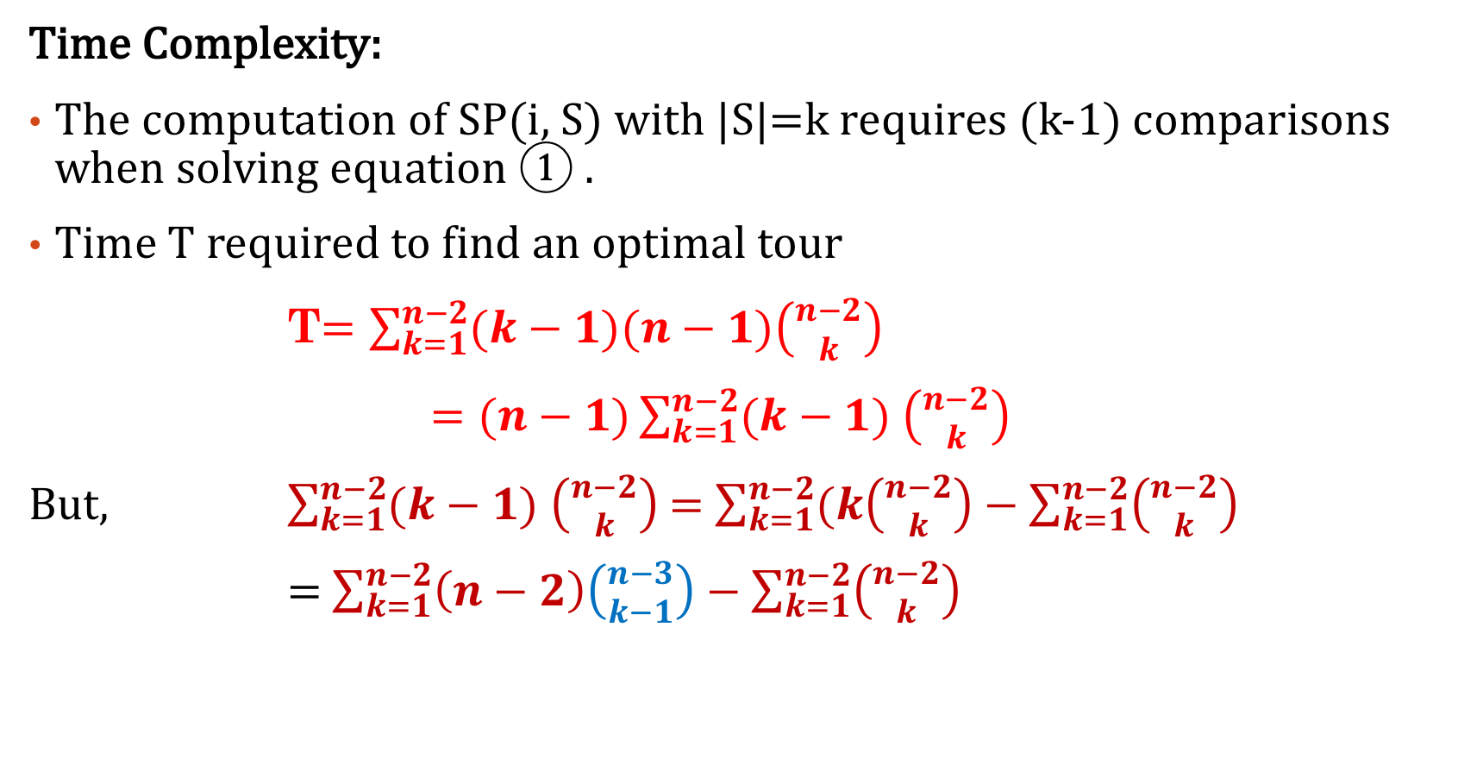
The Travelling Salesman Problem
Time Complexity:
The computation of SP(i, S) with |S|=k requires (k-1) comparisons when solving equation ① .
Time T required to find an optimal tour
T$=\sum_{k=1}^{n−2}{(k−1)(n−1)\left({n−2 \atop k}\right)}$
$=(n−1)\sum_{k=1}^{n−2}{(k−1) \left({n−2 \atop k}\right)}$
But, $\sum_{k=1}^{n−2}{(k−1) \left({n−2 \atop k}\right)}$ = $\sum_{k=1}^{n−2}{(k\left({n−2 \atop k}\right)−\sum_{k=1}^{n−2}{\left({n−2 \atop k}\right)}}$
= $\sum_{k=1}^{n−2}{\left(n−2\right)\left({n−3 \atop k−1}\right)−\sum_{k=1}^{n−2}{\left({n−2 \atop k}\right)}}$
$$∵for integer k, k\left({r \atop k}\right)=r.\left({r−1 \atop k−1}\right)$$

Slide 66
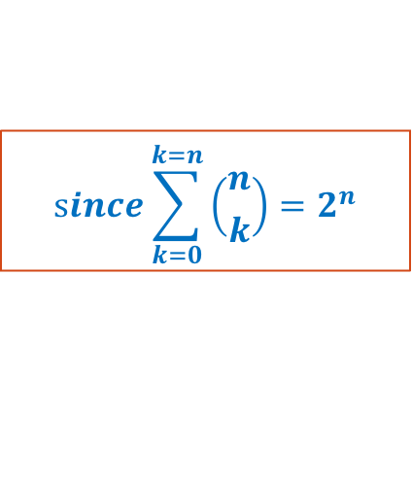
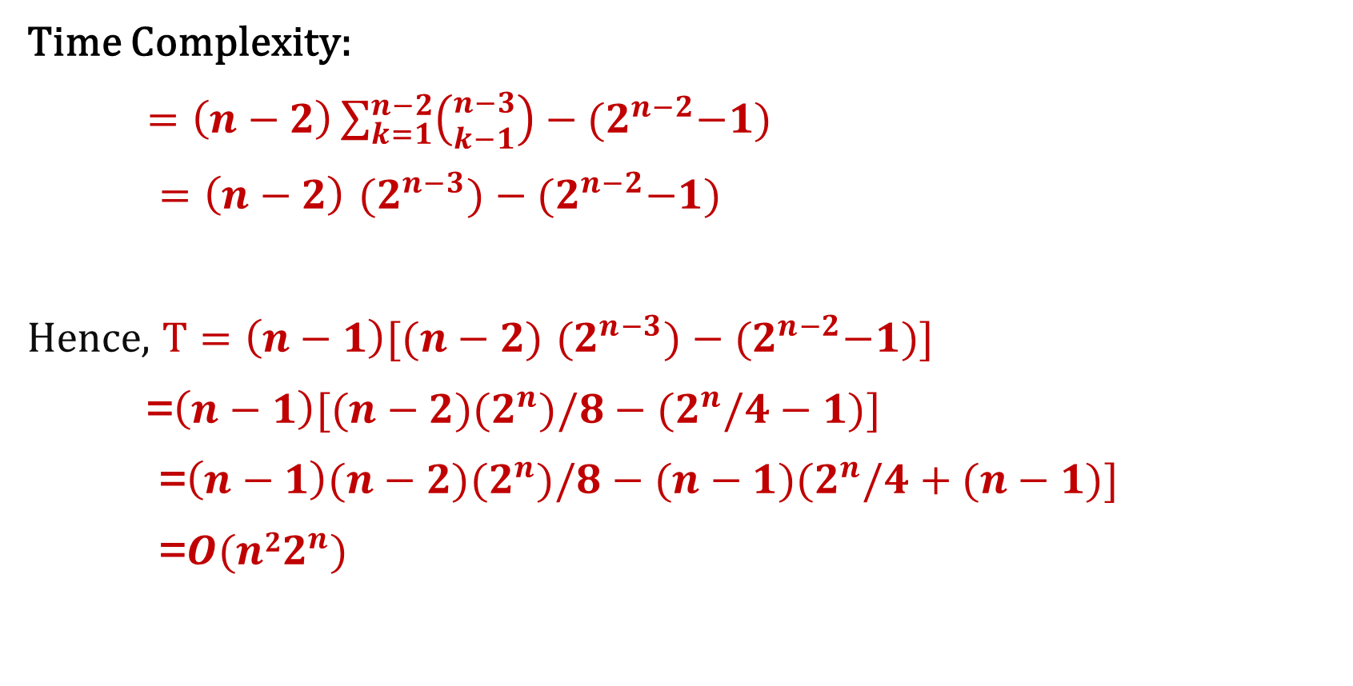
The Travelling Salesman Problem
Time Complexity:
$=\left(n−2\right)\sum_{k=1}^{n−2}{\left({n−3 \atop k−1}\right)−{(2}^{n−2}−1)}$
$=\left(n−2\right)$ ${(2}^{n−3})−{(2}^{n−2}−1)$
Hence, $T=\left(n−1\right)[(n−2)$ ${(2}^{n−3})−{(2}^{n−2}−1)]$
=$\left(n−1\right)[(n−2){(2}^{n})/8−{(2}^{n}/4−1)]$
=$\left(n−1\right)(n−2){(2}^{n})/8−{(n−1)(2}^{n}/4+(n−1)]$
=$O(n{22}^{n})$
$$since\sum_{k=0}^{k=n}{\left({n \atop k}\right)=2^{n}}$$

Slide 67
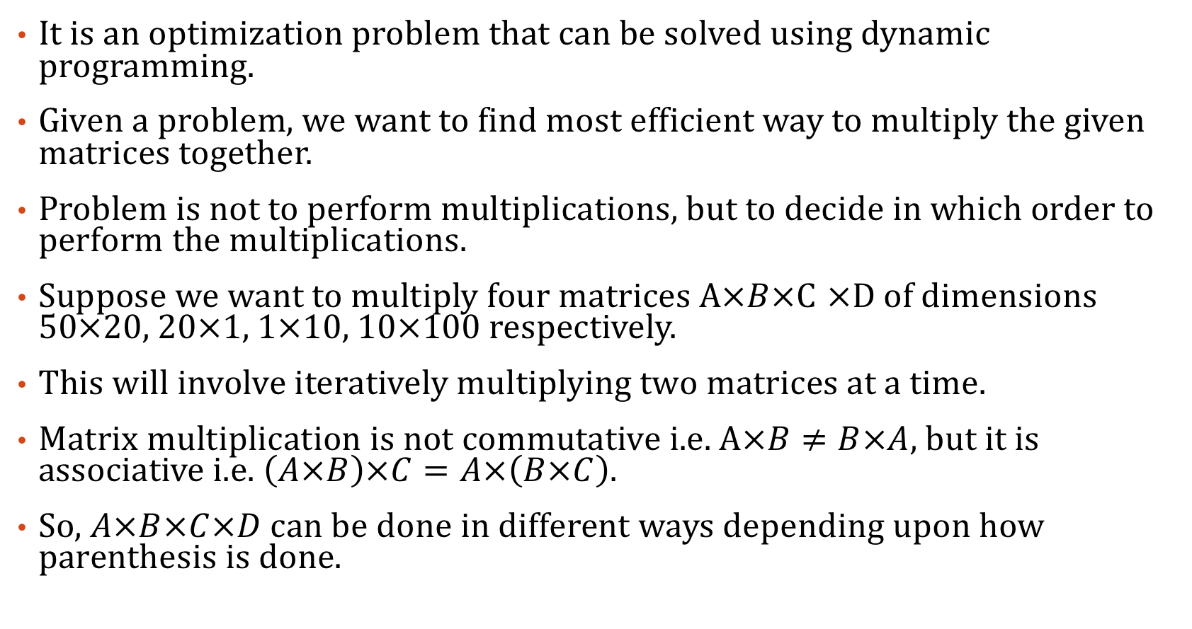
Matrix Chain Multiplication
It is an optimization problem that can be solved using dynamic programming.
Given a problem, we want to find most efficient way to multiply the given matrices together.
Problem is not to perform multiplications, but to decide in which order to perform the multiplications.
Suppose we want to multiply four matrices $A×B×$C $×$D of dimensions 50$×$20, 20$×$1, 1$×$10, 10$×$100 respectively.
This will involve iteratively multiplying two matrices at a time.
Matrix multiplication is not commutative i.e. $A×B≠B×A$, but it is associative i.e. $\left(A×B\right)×C=A×\left(B×C\right).$
So, $A×B×C×D$can be done in different ways depending upon how parenthesis is done.

Slide 68
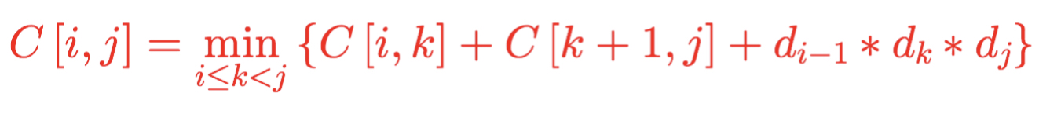


Matrix Chain Multiplication
A is having dimensions (50x20)
B is having dimension (20x1)
C is having dimension (1x10)
D is having dimension (10x100)
$A×B×C×D$ = $A×(B×C)×D$= $\left(A×\left(B×C\right)\right)×D=((A×(B×C))×D)$
Generalised Recursive Formula:

Slide 69
Matrix Chain Multiplication
Example:
Find optimal multiplication of the chain of 4 matrices
A1, A2, A3, A4 with dimension 3x2, 2x4, 4x2 and 2x5
respectively.
So, here P[d₀, d₁, d₂, d₃, d₄] = P[3, 2, 4, 2, 5]

Slide 70
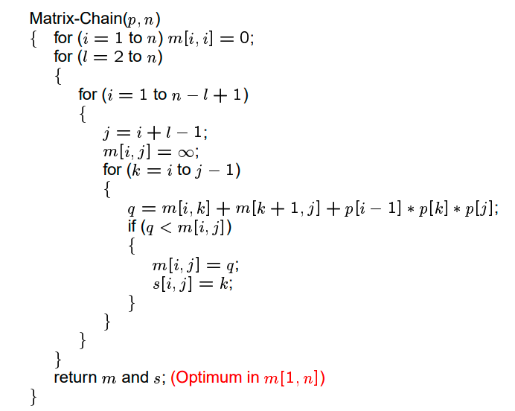

Matrix Chain Multiplication
Algorithm: To find value of an optimal solution.

Slide 71

Matrix Chain Multiplication
Algorithm: Construct an optimal solution

Slide 72


Matrix Chain Multiplication
Example 2:

Slide 73
Longest Common Subsequence(LCS)
A Subsequence of a sequence is the same sequence with some elements (possibly none) left out.
Given a sequence X = (x₁, x₂, x₃…, x_{m}), the subsequence of X is (x_{i1}, x_{i2}, x_{i3} …, x_{ik}) where i₁<i₂<i₃<…<i_{k}.
For example, given the sequence X=(B C D B A C G H),
(B D A C) and (C A G H) are some of the subsequence of X

Slide 74
Longest Common Subsequence(LCS)
Given two sequences X and Y, a sequence Z is a common subsequence of X and Y
For Example, X= (A D C B E J M) and Y = (B A C D E B M), then the sequence (D B M) having length 3 is common subsequence of both X and Y.
However, (D B M) is not longest common subsequence of X and Y.
Subsequence (A D B M) of length 4 common to both X and Y.
Longest Common subsequence problem is stated below:
“Given two sequence X=(x₁, x₂, x₃…, x_{m}) and Y=(y₁, y₂, y₃…, y_{n}), find a maximum length common subsequence of X and Y.”

Slide 75

Longest Common Subsequence(LCS)
Recursive Formula:

Slide 76

Longest Common Subsequence(LCS)
Example: 1
Find the Longest Common Subsequence of the sequences
X = (A D C B E J M) and
Y = (B A C D E B M)

Slide 77

Longest Common Subsequence(LCS)
Algorithm:

Slide 78

Longest Common Subsequence(LCS)
Algorithm:

